Slide 1
Spy on future programming methods and ideas through SwiftUI
通过SwiftUI 窥探未来编程方式和思路

Slide 2
SwiftUI layout vs Traditional layout
SwiftUI布局VS传统布局
Imperative programming: how to do it
Declarative programming: what to do
指令式编程： 怎么做
声明式编程： 做什么
Imperative programming: describes the process and expects the program to execute to get the results we want, while declarative programming describes the results
指令式编程:是描述过程，期望程序执行以得到我们想要的结果,而声明式编程则是描述结果
Demo: BaseView 新项目只有两个文件，演示swiftUI的一些基础语法

Slide 3
SwiftUI 优势
1.Canvas preview is powerful
1.画布预览功能强大
2.Support drag and drop programming
2.支持拖拽编程
3.Powerful internationalization preview
3.强大的国际化预览
4.Fast model adaptation
4.快速机型适配 Demo： Layout
5. Animation improvements
5.动画改进 Demo： AnimationTest
6. Quickly build the UI with a small amount of code, which is the same as the traditional way
6.快速搭建UI使用少量代码对于与传统方式 如List，Scrollview
7.对view解耦，可单独预览和编辑
1.画布预览功能强大

Slide 4
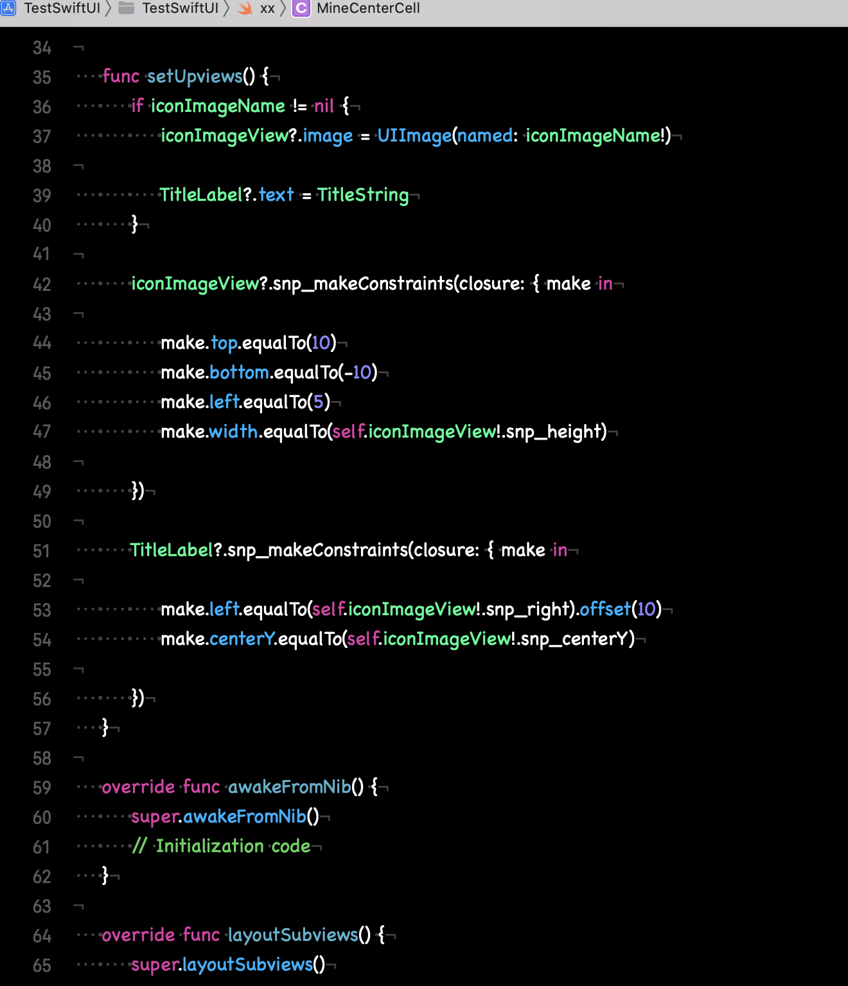
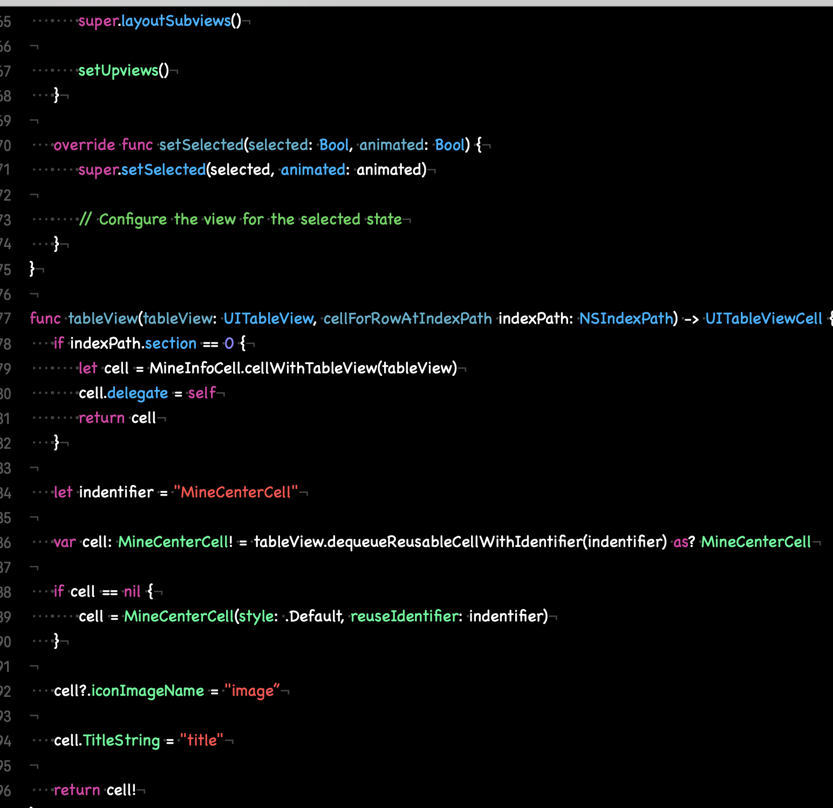
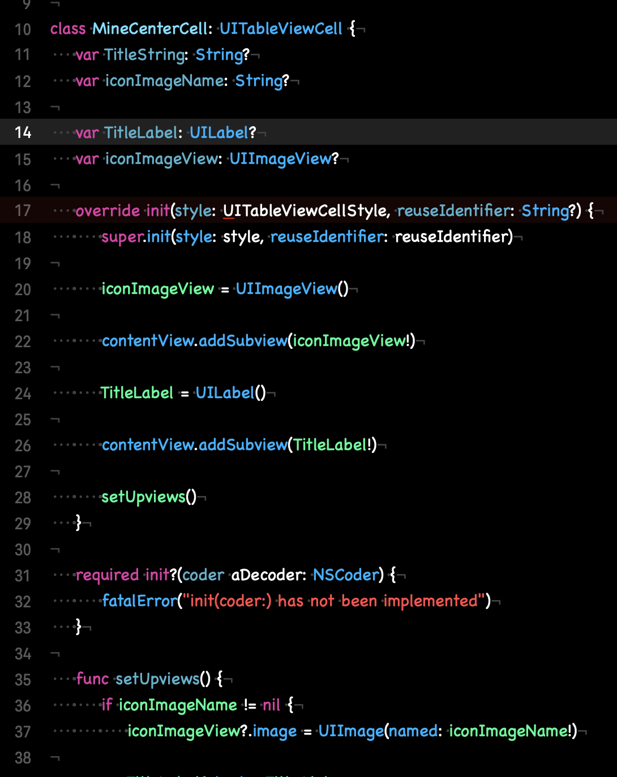

Slide 5
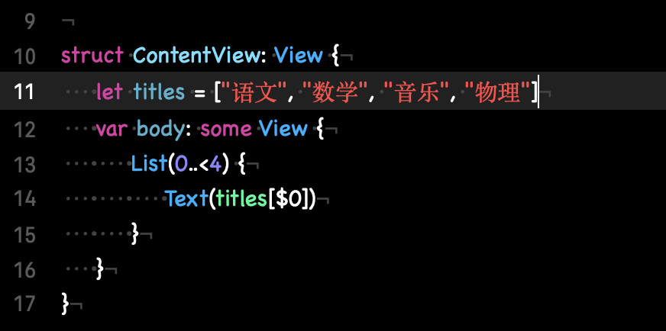

Slide 6
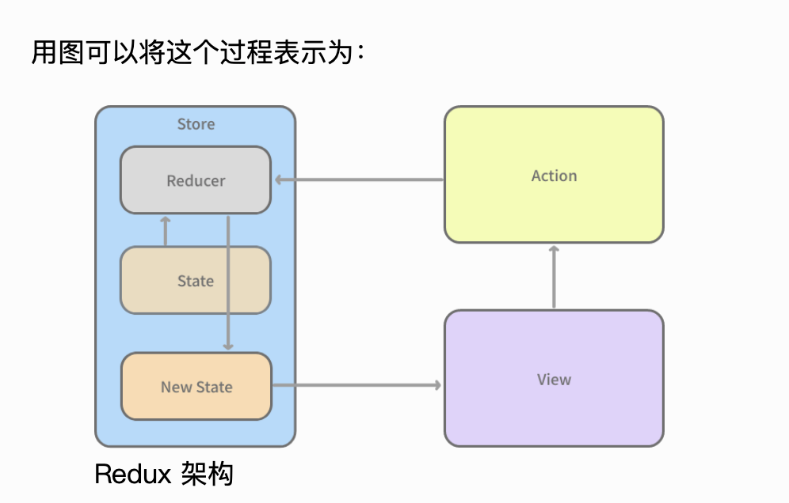
SwifUI one-way data flow
SwifUI单向数据流
Demo： SingleDataSource

Slide 7
Disadvantages of SwiftUI
SwiftUI的缺点
1. The canvas has many bugs and is not stable
1.画布bug较多，还不稳定
2. The swiftUI interface is unstable, sometimes there is a difference of 0.1 version or even the performance of xcode12 and xcode13 are inconsistent, which is not friendly to novice developers or intermediate developers
2.swiftUI接口不稳定，有时相差0.1一个版本甚至xcode12和xcode13表现都不一致，对新手开发者或者中等开发者不友好，甚至抓狂
3. Poor state handling will cause abnormal page refresh
3.状态处理不好，会导致页面刷新异常
It is inconvenient to debug, and some traditional ways to solve bugs cannot be used
4.不方便调试，传统的一些解决bug的方式无法使用
总结：未来的编程的方向所见即所得
编程是简单的，简洁的，至少UI上是的，程序员对于UI搭建甚至可
以拖拖积木就可以完成把更多的重心放在业务上
可以算上一种新的编程思想，使用申明式编程单一数据源让逻辑清晰
Summary: What you see is what you get in the future of
programmingProgramming is simple and concise, at least on
the UI, the programmer can even drag and drag the
building blocks to complete the UI construction.Put more
focus on businessIt can be counted as a new programming
idea, using declarative programming with a single data
source to make the logic clear

Slide 8
Interesting swiftUI Demo
有趣的swiftUI Demo
https://github.com/amosgyamfi/swiftui-animation-library
https://github.com/Shubham0812/SwiftUI-Animations
https://github.com/Inncoder/SwiftUI-Animations

Slide 9
Thank you

